Slide 1
PROTECTING THE SECRECY OF VIDEO USING ADVANCED DATA HIDING TECHNIQUE
BY
JAYAPRIYA.M 211419205079 GUIDED BY JENI PRECILLA.M 211419205082 Mrs.K.MUTHULAKSHMI
MONICA.M 211419205108

Slide 2
ABSTRACT
We propose a advanced video hiding technique to protect the data which need to be secure so that the piracy and the security of the data is maintained without falling into wrong hands.
The message or data such as text , audio , video and files are embedded into a video .The video is of Audio Video Interleave (AVI) format and the data is embedded using h.264 algorithm , slicing and macro block technique.
The video is secured using encryption and decryption using Advanced Encryption Standard (AES) algorithm. The sender secures the video using a key , the receiver can retrieve the data only when the key is entered thus by protecting the data.
This method is used to transfer information securely by hiding the data in a video, the third party doesn't know that there is a data hidden in video , they look just like a normal video without any traces of the data hidden inside it.

Slide 3
SCOPE OF PROJECT
Multi party content hiding has become an important demand for network media to protect all parties rights.
A cryptography scheme in Encrypted data with hiding video secure multiple content hiding in video master file on lightweight cryptography is proposed.
Additive secret sharing and block- level scrambling are developed to generate the encrypted text and embedded file, image, audio into master file video.
The cryptography based on significant bit Prediction Expansion is performed by Secure video text embedded file technique.

Slide 4
OBJECTIVES
A robust method of imperceptible audio, video, text and image hiding is proposed.
The motion vector technique is found as the better solution since it hides the data in the moving objects. The most secure and cryptography algorithm is introduced.
Here a more secure and effective hash based algorithm that uses a pure hash technique for coding and decoding the information in video hiding.

Slide 5
EXISTING SYSTEM
Watermarking digital files is very easy. You can create images that include the copyright symbol or other visual identifiers within the image itself. Even if someone else copied it, you can be sure it's yours.
Watermarks make it easier to see the entire image ,but the downside is that they can be easily removed by a malicious person with a simple image editor. However, the big drawback is that the image itself becomes difficult to see.
In some applications sub-assistants or channel admins would like to add original message like this information, pictorial representation or validating data to the encoded image without the knowledge of the original image complexity.
However, data hiding techniques which has been developed for the image can be easily used to constricted video and are therefore sometimes inspected

Slide 6
DISADVANTAGE
In the content text is plaintext domain results in the leakage of privacy.
The visual quality of the marked image is not high.
The schemes are fragile to noise attacks and image compression.
The quality of image and text will be identify by hacker.

Slide 7
PROPOSED SYSTEM
Earlier various kinds of cryptography techniques are introduced for the video.
Here we proposed the Hash Based Least Significant Bit Technique for Video cryptography which performs insertion of bits of text file and pdf file, audio, image file in video in the least significant bit position of RGB pixel as per hash function.
In this way it includes slicing technique and macro blocking in Encoding and Decoding process for hiding message and extracting message respectively. In this technique cryptography which perform Encoding and Decoding.
First of all text will be embedded within the video by using the slicing technique Motion vector prediction.
This AVI format video file is again applied to cryptography tool to decode embedded data. There is use of following algorithm for data hiding.

Slide 8
ADVANTAGE
In Military there is requirement to hide secret message from unintended receiver like terrorist.
Businessman can use this technique to hide a data from business rivels.
The observer have no idea that a secret data is hidden in a video. So there will be no chances to alter the data.
We can hide data and image, audio, text file using cryptography.

Slide 9
SYSTEM CONFIGURATION
H/W SYSTEM CONFIGURATION
Processor - i3,i5,i7
RAM - 4 GB
Hard Disk - 500 GB

Slide 10
S/W SYSTEM CONFIGURATION
Operating System - 7/8/10
Front End - Java
Database - My sql
Database Connectivity - JDBC.

Slide 11
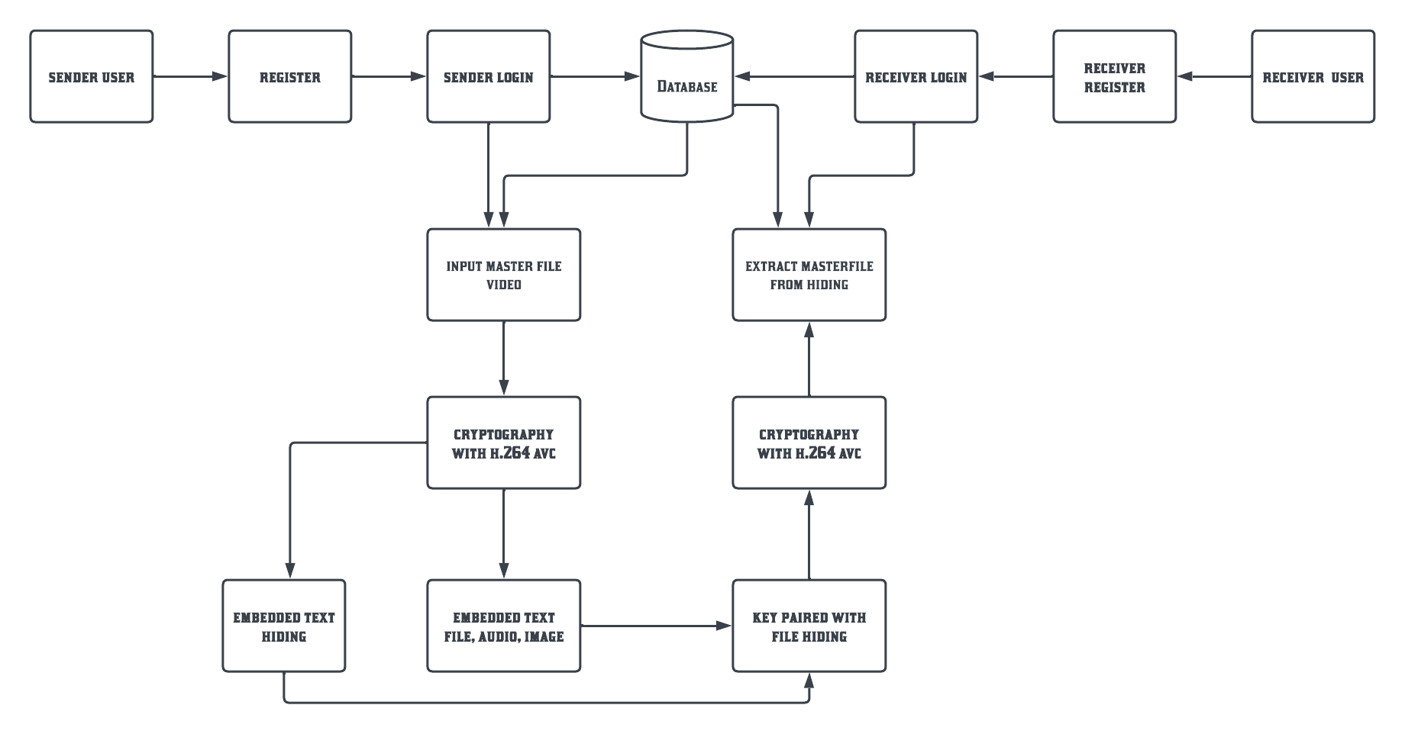
SYSTEM ARCHITECTURE

Slide 12
LITERATURE SURVEY
S.NO | Name of the paper with year | Objective | Pros | Cons
1 | Research on Digital Image Watermarking Algorithm Based on Scrambling and Singular Value Decomposition Year: 2022 | At present, the digital image watermarking algorithm has not embedded the synchronization signal in the image, resulting in the poor performance of the embedded image in terms of, imperceptibility, anti-attack ability, and robustness. therefore, a digital image watermarking algorithm based on scrambling and singular value decomposition is proposed.. The experimental result show that the algorithm can extract the watermark information completely, the image contrast and singular value have been anti-attack performance. | The image has good quality,stand strong against attack and has good visual effect. | The watermarkimage may be used in illegal way and the watermarkcan be removed easily.

Slide 13
LITERATURE SURVEY
TITLE 2: Image Watermarking between Conventional and Learning-Based Techniques: A Literature Review
AUTHOR: Said Boujerfaoui , Rabia Riad , Hassan Douzi , Frédéric Ros and Rachid Harba
ABSTRACT:
Currently, most transactions and exchanges are conducted through the Internet thanks to technological tools, running the risk of the falsification and distortion of information. This is due to the massive demand for the virtual world and its easy access to anyone. Image watermarking has recently emerged as one of the most important areas for protecting content and enhancing durability and resistance to these kinds of attacks. However, there is currently no integrated technology able to repel all possible kinds of attacks; the main objective of each technology remains limited to specific types of applications, meaning there are multiple opportunities to contribute to the development of this field. Recently, the image watermarking field has gained significant benefits from the sudden popularity of deep learning and its outstanding success in the field of information security. Thus, in this article, we will describe the bridge by which the watermarking field has evolved from traditional technology to intelligent technologies based on deep learnin
S.NO | Name of the paper with year | Objective | Pros | Cons
2 | Image Watermarking between Conventional and Learning-Based Techniques: A Literature Review Year: 2022 | Currently, most transactions and exchanges are conducted through the Internet thanks to technological tools, running the risk of the falsification and distortion of information. This is due to the massive demand for the virtual world and its easy access to anyone. Image watermarking has recently emerged as one of the most important areas for protecting content and enhancing durability and resistance to these kinds of attacks. However, there is currently no integrated technology able to repel all possible kinds of attacks; the main objective of each technology remains limited to specific types of applications, meaning there are multiple opportunities to contribute to the development of this field. Recently, the image watermarking field has gained significant benefits from the sudden popularity of deep learning and its outstanding success in the field of information security. Thus, in this article, we will describe the bridge by which the watermarking field has evolved from traditional technology to intelligent technologies based on deep learning. | Secret information which may be Needed in case of emergency situation can be sent through secure transaction method as technology has been improved. | Hackers can easily get the content when the hidden file has any form of hints

Slide 14
LITERATURE SURVEY
S.NO | Name of the paper with year | Objective | Pros | Cons
3 | MultipurposeWatermarkingAlgorithm for Medical Images Year: 2022 | Considering the existing medical image watermarking algorithms, a single function often has limitations, and a multipurpose watermarking algorithm for medical images is proposed. First, medical images are divided into regions of interest (ROIs) and regions of noninterest (RONIs). ,en, the authentication watermark produced for each subblock of the ROI is embedded into the corresponding mapping subblock. ,e visible watermark is embedded into the RONI, and, finally, the watermark information and constructed authentication information in each subblock of the ROI are embedded into the corresponding RONI subblock. | algorithm has strong robustness and very good visual quality. It can simultaneously realize copyright protection and content authentication and also has high tamper localization capability. | Considering the existing medical image watermarking algorithms, a single function often has limitations,

Slide 15
LITERATURE SURVEY
S.NO | Name of the paper with year | Objective | Pros | Cons
4 | Multiple Histograms Shifting-Based Video Data Hiding Using Compression Sensing Year : 2022 | With the development of multimedia editing technologies, the copyright protection has attacked more attentions. Reversible data hiding (RDH), in which the cover can be recovered losslessly, is an effect method to eliminate embedding distortions. As a typical RDH method, histogram shifting (HS) is used widely. Most existing RDH schemes based on HS usually build sharp histograms by predicting and sorting techniques. To make use of spatial correlations of multimedia, several RDH schemes based on multiple HS (MHS) are proposed to protect copyright, in which some rigid rules are used to build multiple histograms. Against images, videos have more spatial and temple correlations and it is easier to acquire sharper histograms. In this paper, a video MHS scheme based on compression sensing (CS) is proposed. | The quality of most test videos in this scheme are higher than that in the state-of-art schemes. | Most existing RDH schemes based on HS usually build sharp histograms by predicting and sorting techniques
TITLE 4: Multiple Histograms Shifting-Based Video Data Hiding Using Compression Sensing
AUTHOR YANLI CHEN , LIMENGNAN ZHOU , YONGHUI ZHOU1 , YI CHEN , (Graduate Student Member, I SHENGBO HU , AND ZHICHENG DONG
ABSTRACT:
With the development of multimedia editing technologies, the copyright protection has attacked more attentions. Reversible data hiding (RDH), in which the cover can be recovered losslessly, is an effect method to eliminate embedding distortions. As a typical RDH method, histogram shifting (HS) is used widely. Most existing RDH schemes based on HS usually build sharp histograms by predicting and sorting techniques. To make use of spatial correlations of multimedia, several RDH schemes based on multiple HS (MHS) are proposed to protect copyright, in which some rigid rules are used to build multiple histograms. Against images, videos have more spatial and temple correlations and it is easier to acquire sharper histograms. In this paper, a video MHS scheme based on compression sensing (CS) is proposed. As a linear sensing algorithm, CS can measure macroblock residuals by reducing corrections among pixels to acquire distinguishable macroblock features, while keeping their statistical characteristics immutable. By employing CS, macroblocks with similar characteristics cluster together to formulate multiple histograms. For each of these histograms, data embedding is implemented to reduce

Slide 16
LITERATURE SURVEY
S.NO | Name of the paper with year | Objective | Pros | Cons
5 | Robust Unsupervised Video Anomaly Detection by Multipath Frame Prediction YEAR: 2021 | Video anomaly detection is commonly used in many applications, such as security surveillance, and is very challenging. A majority of recent video anomaly detection approaches utilize deep reconstruction models, but their performance is often suboptimal because of insufficient reconstruction error differences between normal and abnormal video frames in practice. Meanwhile, frame prediction-based anomaly detection methods have shown promising performance. In this article, we propose a novel and robust unsupervised video anomaly detection method by frame prediction with a proper design which is more in line with the characteristics of surveillance videos. | Can better handle semanticallyinformative objects and areas of different scales and capture spatial-temporal dependencies in normal videos. | The performanceis often suboptimal because of insufficient reconstructionerror differences between normal and abnormal video frames in practice.
TITLE 5: Robust Unsupervised Video Anomaly Detection by Multipath Frame Prediction
AURHOR: FABIEN A. P. PETITCOLAS, ROSS J. ANDERSON, AND MARKUS G. KUHN
ABSTRACT:
Video anomaly detection is commonly used in many applications, such as security surveillance, and is very challenging. A majority of recent video anomaly detection approaches utilize deep reconstruction models, but their performance is often suboptimal because of insufficient reconstruction error differences between normal and abnormal video frames in practice. Meanwhile, frame prediction-based anomaly detection methods have shown promising performance. In this article, we propose a novel and robust unsupervised video anomaly detection method by frame prediction with a proper design which is more in line with the characteristics of surveillance videos. The proposed method is equipped with a multipath ConvGRU-based frame prediction network that can better handle semantically informative objects and areas of different scales and capture spatial-temporal dependencies in normal videos. A noise tolerance loss is introduced during training to mitigate the interference caused by background noise. Extensive experiments have been conducted on the CUHK

Slide 17
LITERATURE SURVEY
S.NO | Name of the paper with year | Objective | Pros | Cons
6 | Separable reversible data hiding in an encrypted image using the adjacency pixel difference histogram Year:2023 | Information security is a practice of encrypting data in movement and on hold, improving discretion and integrity. One can protect, encrypt and decrypt critical data in several ways. One of them is reversible data hiding in and encrypted image. The technique enables the user to encrypt images that need authentication and restore them to their original form of images. This technique returns a lossless image as an output making it the most suitable for medical images and the military. Histogram shifting of pixel difference is an effectual reversible data hiding method in information security. | the grayscale image transfer is carried out exceedingly safely, with near-zero correlation and Entropy closer to 8.the secret and cover images are retrieved without error. | In these schemes, the original cover cannot be recovered completely without distortion due to data embedding

Slide 18
LITERATURE SURVEY
S.NO | Name of the paper with year | Objective | Pros | Cons
7 | Flexible patch moving modes for pixel-value-ordering based reversible data hiding methods Year:2023 | Pixel-value-ordering (PVO) is one of the most popular frameworks in the research of reversible data hiding (RDH) in recent years. In most PVO-based methods, the cover image is divided into non-overlapped blocks to embed secret data into the maximum and minimum pixels of each block. In these methods, the imag division processing is just like moving a patch with constant step lengths in both horizontal and vertical directions. | It achieves an obvious improvement in fidelity when compared with some state-of-the-art RDH schemes. | The block amount, as well as the embeddingcapacity (EC), is limited by the image size and the patch size.

Slide 19
LITERATURE SURVEY
S.NO | Name of the paper with year | Objective | Pros | Cons
8 | Secure Data Hiding and Extraction Using RSA AlgorithmYear:2023 | Data hiding and extraction is an important aspect of information security because the data will be safer and more manageable. Data hiding technology that works well produces data that is efficient, secure, and simple to connect. The underlying communication network that enables the transport of sensitive data is insecure and unprotected. The fast rise of electronic methods of communication implies that information security has become a critical concern in the real world. | There is a guarantee for the increase level of confidentiality of information exchange over the internet. | The The communication network that enables the transport of sensitive data is insecure and unprotected

Slide 20
LITERATURE SURVEY
S.NO | Name of the paper with year | Objective | Pros | Cons
9 | A secure data hiding approach based on least- significant-bit and nature-inspired optimization techniquesYear:2022 | With remarkable information technology development, information security has become a major concern in the communication environment, where security must be performed for the multimedia messages exchanged between the sender and the intended recipient. Digital multimedia steganography techniques have been developed.The objective function is used to determine the ideal encoding vector to convert the secret message to its encoded form. The proposed approach performs better than other state-of-the-art methods in terms of standard measures of visual quality with maintaining high embedding capacity. Comparisons with existing LSB or multi-directional PVD embedding methods demonstrate that the proposed method has more optimized and higher embedding capacity with maintaining visual quality. Besides, the proposed approach achieves high security against | High security against statistical Stego Expose analysis, ALASKA2 deep learning steganalysis, and image processing attacks is provided. | The security of multimedia messages exchanged between the sender and the intended recipient is less.

Slide 21
LITERATURE SURVEY
S.NO | Name of the paper with year | Objective | Pros | Cons
10 | Improving data hiding within colour images using hue component of HSV colour space Year:2022 | Data hiding technologies aim to hide the existence of secret information within digital covers such as images by causing unnoticeable degradation to their quality. Reducing the image distortion and increasing the embedding capacity are the main points that the data hiding techniques revolved around. This article proposes two high payload embedding methods with high stego image quality using the Hue-Saturation-Value (HSV) colour model. | It has two high payload embedding methods with high stego image quality using the Hue-Saturation-Value (HSV) colour model. | With the widespread use of the Internet, sensitive contents have become more exposed to penetration by intruders.

Slide 22
MODULES
SLICING
MOTION COMPENSATION
MOTION VECTOR PREDICTION
BLOCK TRANSFORMATION AND ENCODING
MACRO BLOCK ORDERING

Slide 23
SLICING
A coded picture is divided into one or more slices. Slices are self-contained and can be decoded and displayed independently of other slices. Hence, intra prediction of DCT coefficients and coding parameters of a macro block is restricted to previous macro blocks within the same slice.
This feature is important to suppress error propagation within a picture due to the nature of variable length coding. In regular encoding, when FMO is not used, slices contain a sequence of macro blocks in raster scan order. However, FMO allows the encoder to create what is known as slice groups.
Each slice group contains one or more slices and macro blocks can be assigned in any order to these slices. The assignment of macro blocks to different groups is signaled by a syntax structure called the “slice group id”.

Slide 24
MOTION COMPENSATION
Using motion compensation, motion between frames can be encoded in a very efficient manner. A typical P-type block copies an area of the last decoded frame into the current frame buffer to serve as a prediction.
If this block is assigned a nonzero motion vector, the source area for this copy process will not be the same as the destination area. It will be moved by some pixels, allowing to accommodate for the motion of the object that occupies that block.
In H.264, motion vector precision is one-quarter pixel. Interpolation is used to determine the intensity values at non-integer pixel positions. Additionally, motion vectors may point to regions outside of the image. In this case, edge pixels are repeated.

Slide 25
MOTION VECTOR PREDICTION
In motion vector the block moves in identical direction.
Motion vector prediction uses encoding.
Now the block uses the neighboring block motion vector to evaluate the current block.
The value stored will only be the variation of the prediction and present vector.

Slide 26
BLOCK TRANSFORMATION AND ENCODING
The basic image encoding algorithm of H.264 uses a separable transformation. The mode of operation is similar to that of JPEG and MPEG, but the transformation used is not an 8x8 DCT, but an 4x4 integer transformation derived from the DCT.
For each block, the actual image data is subtracted from the prediction. The resulting residual is transformed. The coefficients of this transform are divided by a constant integer number. This procedure is called quantization, it is the only step in the whole encoding process that is actually lossy. The divisor used is called the quantization parameter.
The quantized coefficients are then read out from the 4x4 coefficient matrix into a single 16-element scan. This scan is then encoded using sophisticated (lossless) entropy coding. In the decoder, these steps are performed in reversed order.

Slide 27
MACROBLOCK ORDERING
The use of the explicit assignment of macro blocks is to slice groups in order to hide messages in the video stream.
Since macro blocks can be arbitrary assigned to slice groups,the slice group ID of individual macro blocks as an indication of message bits is used.
Assume for instance that two slice groups are used, the allocation of a macro block to slice group 0 indicates a message bit of 0 and the allocation of macro block to slice group 1 indicates a message bit of 1.
Hence, one message bit per macro block can be carried.

Slide 28
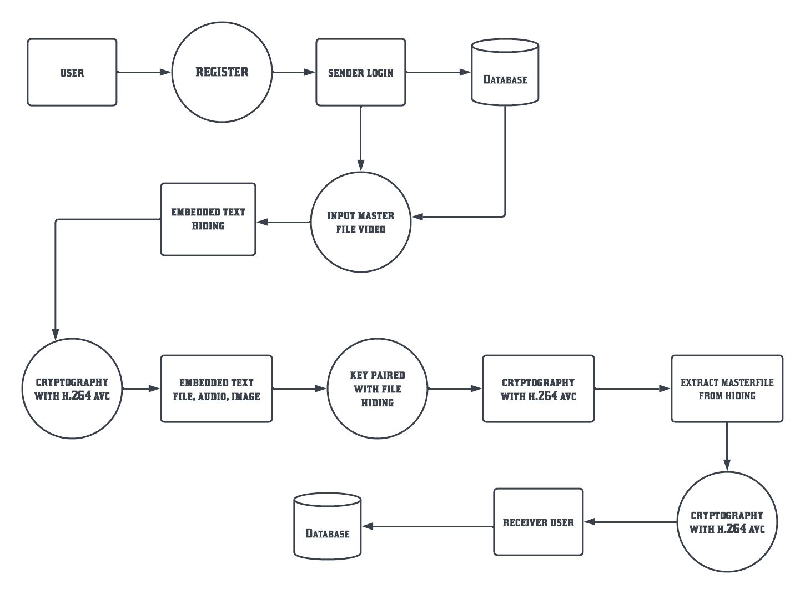
OVERALL FLOW DIAGRAM

Slide 29
EMBEDDING ALGORITHM
Step 1: Extract Bit set of Message, Bit={M0, M1,……, M65535 }
Step 2: The Pixels of cover image, Pixel = {pixel0, pixel,…, pixel65535}
Step 3: Extract LSB-1 set of the cover image, LSB1={A0, A1,…,A65535}.
Step 4: Extract LSB-2 set of the cover image, LSB2={B0, B1,…, B65535}.
Step 5: For i=1 to message length does
{
If Mi= =Bi
Then do nothing
Else {
If Mi= =1 and Bi= =0 Then 40
{
Bi=Mi; Ai=0;
Pixel (i)-=1
}
Else If Mi= =0 and Bi= =1 Then
{
Bi=Mi; Ai=1; Pixel (i)+=1
} } }

Slide 30
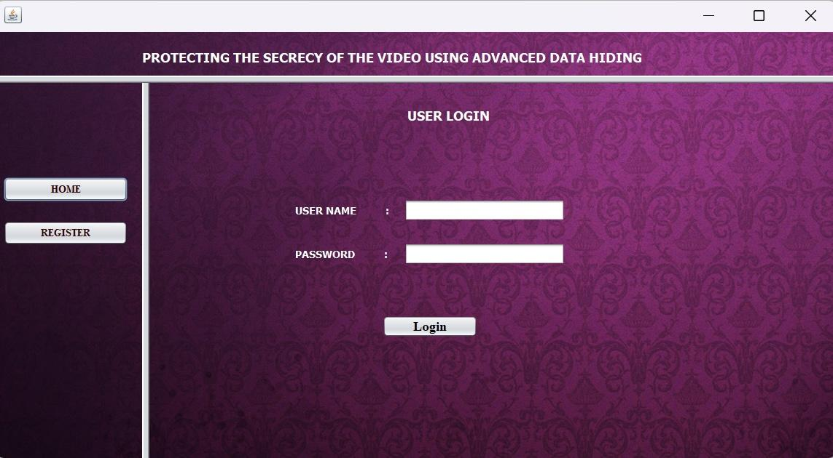
SCREENSHOT
User can first register and then login by using the user credentials.

Slide 31
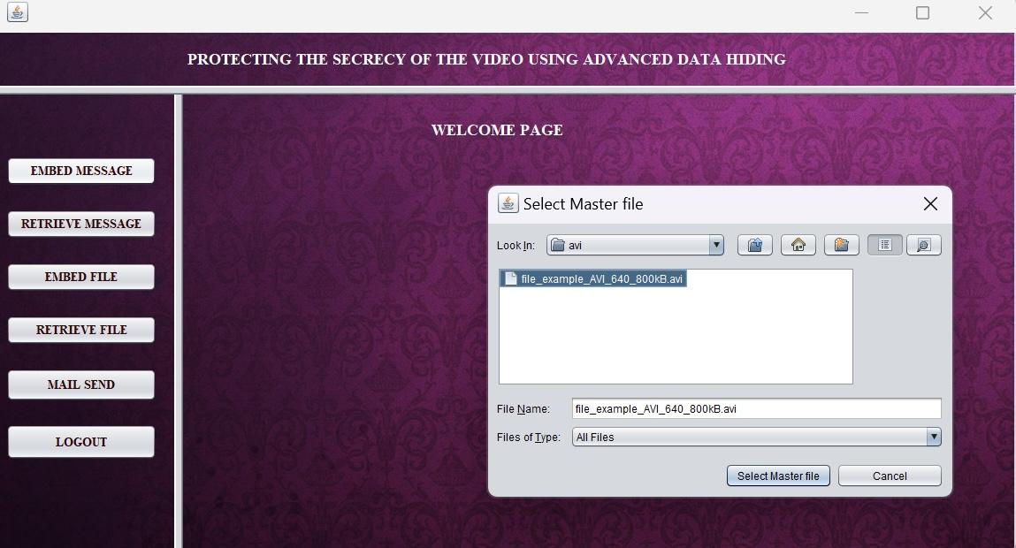
Select the master video and the output video which need to be sent by embedding the data.

Slide 32
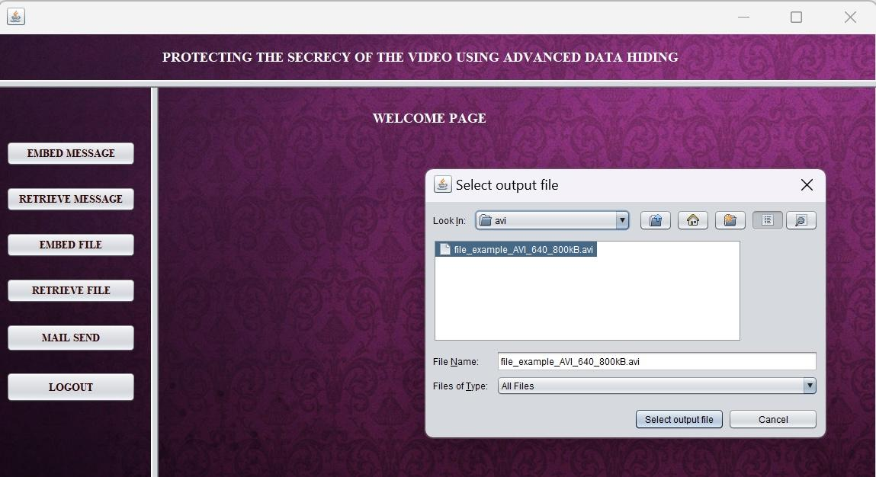
Give the text message need to be hidden in the master file given and secure the file using key.

Slide 33
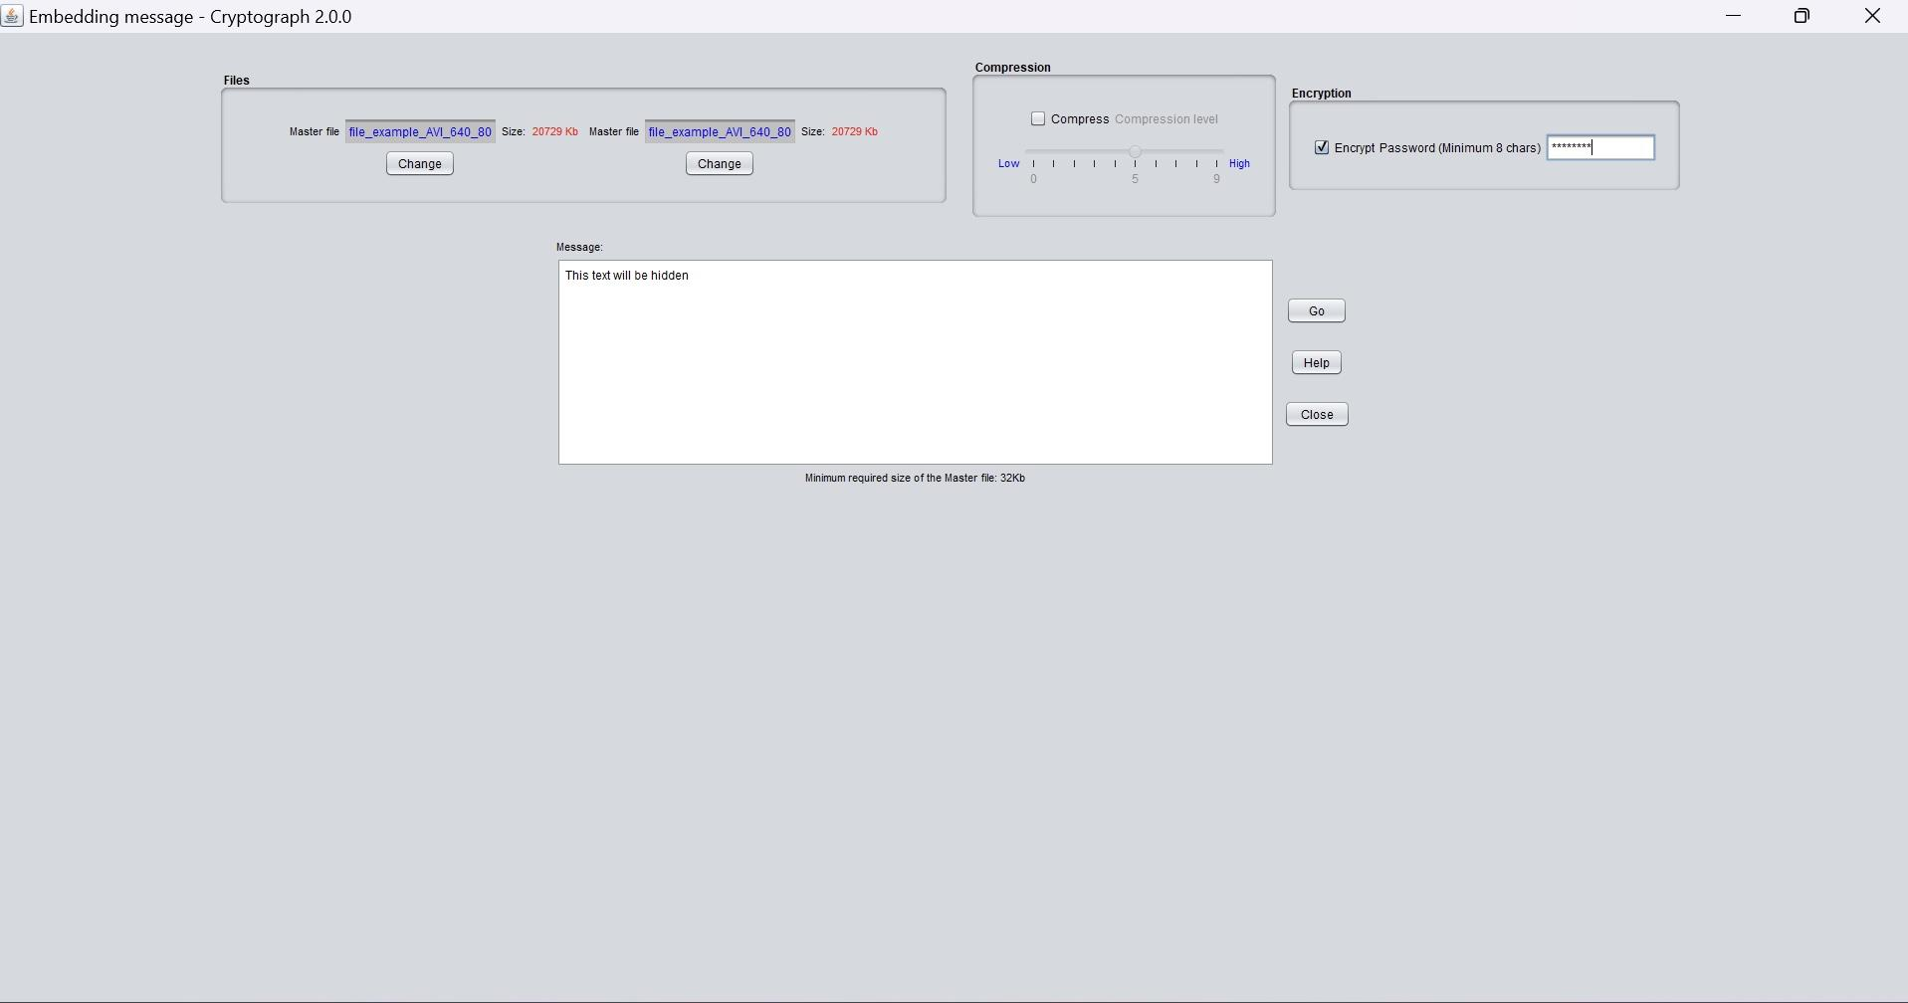
Retrieve the text message by selecting the output file and enter the key to view the hidden message.

Slide 34
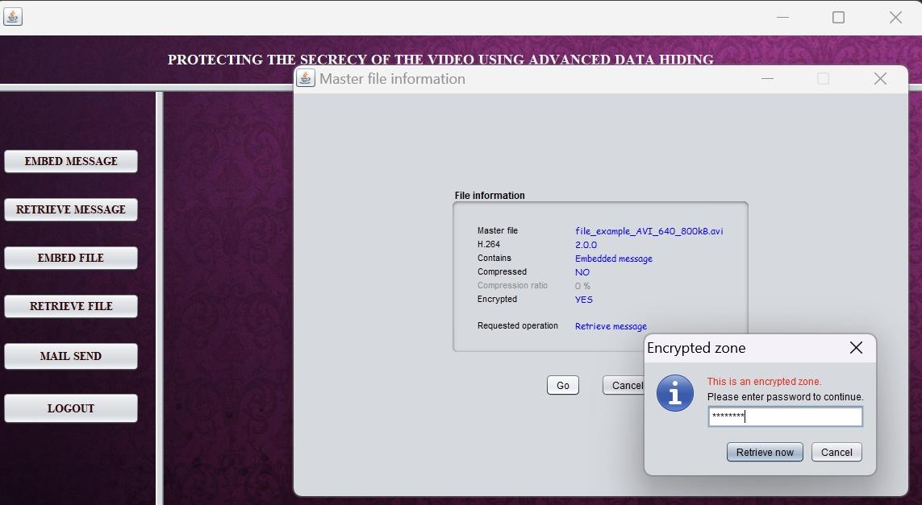
Now the hidden information is separated from the video and the text message is displayed.

Slide 35

To hide an image select the master ,output and the image needed to be hidden and secure it with key.

Slide 36

Retrieve the image from the file by entering the key. The hidden image is extracted from the video.

Slide 37

To embed a video in a video select a video as a master file and as a output file. The video that need to be hidden is selected as data file.
By giving a key and go option the video is embedded into the video, successful message is displayed. To separate the hidden video, give the key to view the original video.

Slide 38
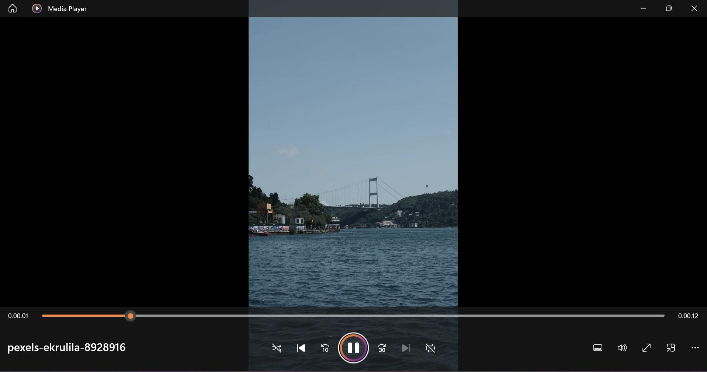
The hidden video is displayed.

Slide 39
CONCLUSION
A data hiding technique for high resolution video by hiding the encrypted text over the video our intension is to provide proper protection on data during transmission.
For the accuracy of the corrects message output that extract from source we can use a tools for comparison and statistical analysis can be done.
It is highly configurable, thus it may result in high data capacities to retrieve the original data. Finally, it can be easily extended, resulting in better robustness, better data security and higher embedding capacity.
Then, categorized the existing information hiding methods based on the venues at which they operate and highlighted their strengths and weaknesses.

Slide 40
REFERENCE
1.Rakhmawati, L.; Wirawan, W.; Suwadi, S. A recent survey of self-embedding fragile watermarking scheme for image authentication with recovery capability. EURASIP J. Image Video Process. 2019, 2019, 61. [CrossRef]
2. Begum, M.; Uddin, M.S. Digital image watermarking techniques: A review. Information 2020, 11, 110. [CrossRef]
3. Ahvanooey, M.T.; Li, Q.; Zhu, X.; Alazab, M.; Zhang, J. ANiTW: A novel intelligent text watermarking technique for forensic identification of spurious information on social media. Comput. Secur. 2020, 90, 101702. [CrossRef]
4. Sharma, C.; Bagga, A.; Singh, B.K.; Shabaz, M. A novel optimized graph-based transform watermarking technique to address security issues in real-time application. Math. Probl. Eng. 2021, 2021, 5580098. [CrossRef]
5. Mohammed, A.A.; Abdullah, M.A.; Awad, S.R.; Alghareb, F.S. A Novel FDCT-SVD Based Watermarking with Radon Transform for Telemedicine Applications. Int. J. Intell. Eng. Syst. 2022, 15, 343–354.]

Slide 41
REFERENCE
6. Sharma, S.; Zou, J.J.; Fang, G. A Novel Multipurpose Watermarking Scheme Capable of Protecting and Authenticating Images With Tamper Detection and Localisation Abilities. IEEE Access 2022, 10, 85677–85700. [CrossRef]
7. Wazirali, R.; Ahmad, R.; Al-Amayreh, A.; Al-Madi, M.; Khalifeh, A. Secure watermarking schemes and their approaches in the IoT technology: An overview. Electronics 2021, 10, 1744. [CrossRef]
8. Amrit, P.; Singh, A.K. Survey on watermarking methods in the artificial intelligence domain and beyond. Comput. Commun. 2022, 188, 52–65. [CrossRef]
9. Sy, N.C.; Kha, H.H.; Hoang, N.M. An efficient robust blind watermarking method based on convolution neural networks in wavelet transform domain. Int. J. Mach. Learn. Comput 2020, 10, 675–684. [CrossRef]

Slide 42
REFERENCE
10.Wang, X.; Ma, D.; Hu, K.; Hu, J.; Du, L. Mapping based residual convolution neural network for non-embedding and blind image watermarking. J. Inf. Secur. Appl. 2021, 59, 102820. [CrossRef]
11. Usha Nandini, D.; Divya, S. A literature survey on various watermarking techniques. In Proceedings of the 2017 International Conference on Inventive Systems and Control (ICISC), Coimbatore, India, 19–20 January 2017; pp. 1–4. [CrossRef]
12. Rani, B.U.; Praveena, B.; Ramanjaneyulu, K. Literature Review on Digital Image Watermarking; ICARCSET ’15; Association for Computing Machinery: New York, NY, USA, 2015. [CrossRef]

